Slide 1
New Growth Plan & Reform and Growth Facility for the Western Balkans
New Growth Plan - Opportunities for the Western Balkans Business Sector - WB6CIF
5 December 2023

Slide 2
Growth Plan for the Western Balkans Challenges and EU response
Where we come from:
Average income per capita in the Western Balkans varies between 27% and 50% of the EU average income
Economic convergence and socio-economic & political reforms are not advancing fast enough
This affects the pace of the accession process
What we want to achieve
Doubling the size of the Western Balkan’ economies within the next decade
Incentivising countries to accelerate the adoption and implementation of the EU acquis
Accelerate the accession process
<<<<<<<<<<<<<<<<

Slide 3
A Growth Plan built on four pillars
Economic growth through reforms and economic integration
To enhance economic integration with the European Union’s Single market.
To boost economic integration within the Western Balkans through the Common Regional Market.
To accelerate fundamental reforms aimed at accelerating accession, improving economic growth and strengthening regional stability.
To increase financial assistance conditional on implementing reforms through a new financing instrument: the Reform and Growth Facility for the Western Balkans worth EUR 6 billion (among which EUR 2 billion are part of the MFF review proposal).
The four pillars are interdependent and mutually reinforce one another. At the center will be the Western Balkans Facility with strong conditionality on the progress on the necessary reforms.

Slide 4
Bringing the Western Balkans closer to the EU single market
The EU will open certain areas of the EU Single Market to the Western Balkan, bringing tangible benefits to its citizen prior to accession.
The focus will be on the following seven initial priority areas:
Free movement of goods
Free movement of services and workers
Access to the Single Euro Payments Area
Facilitation of Road transport
Integration and de-carbonisation of the Energy Markets
Digital Single Market
Integration into industrial supply chains
Access to the EU’s Single market will only be granted if the Western Balkan countries give their neighbours access to their own market (pillar 2).

Slide 5
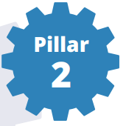
Deepening the Regional Economic Integration within the Western Balkans
1
The Common Regional Market (CRM) is vital to overcome small fragmented markets, make businesses competitive, attract investors and retain workers. Based on EU rules, it is a stepping-stone to the opportunities of the Single Market.
Substantial opportunities for integration in the EU’s single market will happen only if the region delivers on regional economic integration.
3
Partners that are not fully committed to the CRM cannot expect to benefit from the opportunities for single market integration.
However, you can only block yourself and not your 5 partners.
2
4

Slide 6
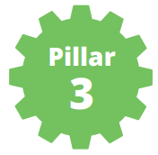
Accelerating Reforms
The Western Balkan partners will need to accelerate reforms to:
Improve economic growth including through attracting foreign investments and strengthening regional stability;
Move ahead towards Regional Common Market, the EU Single Market and the EU membership.

Slide 7
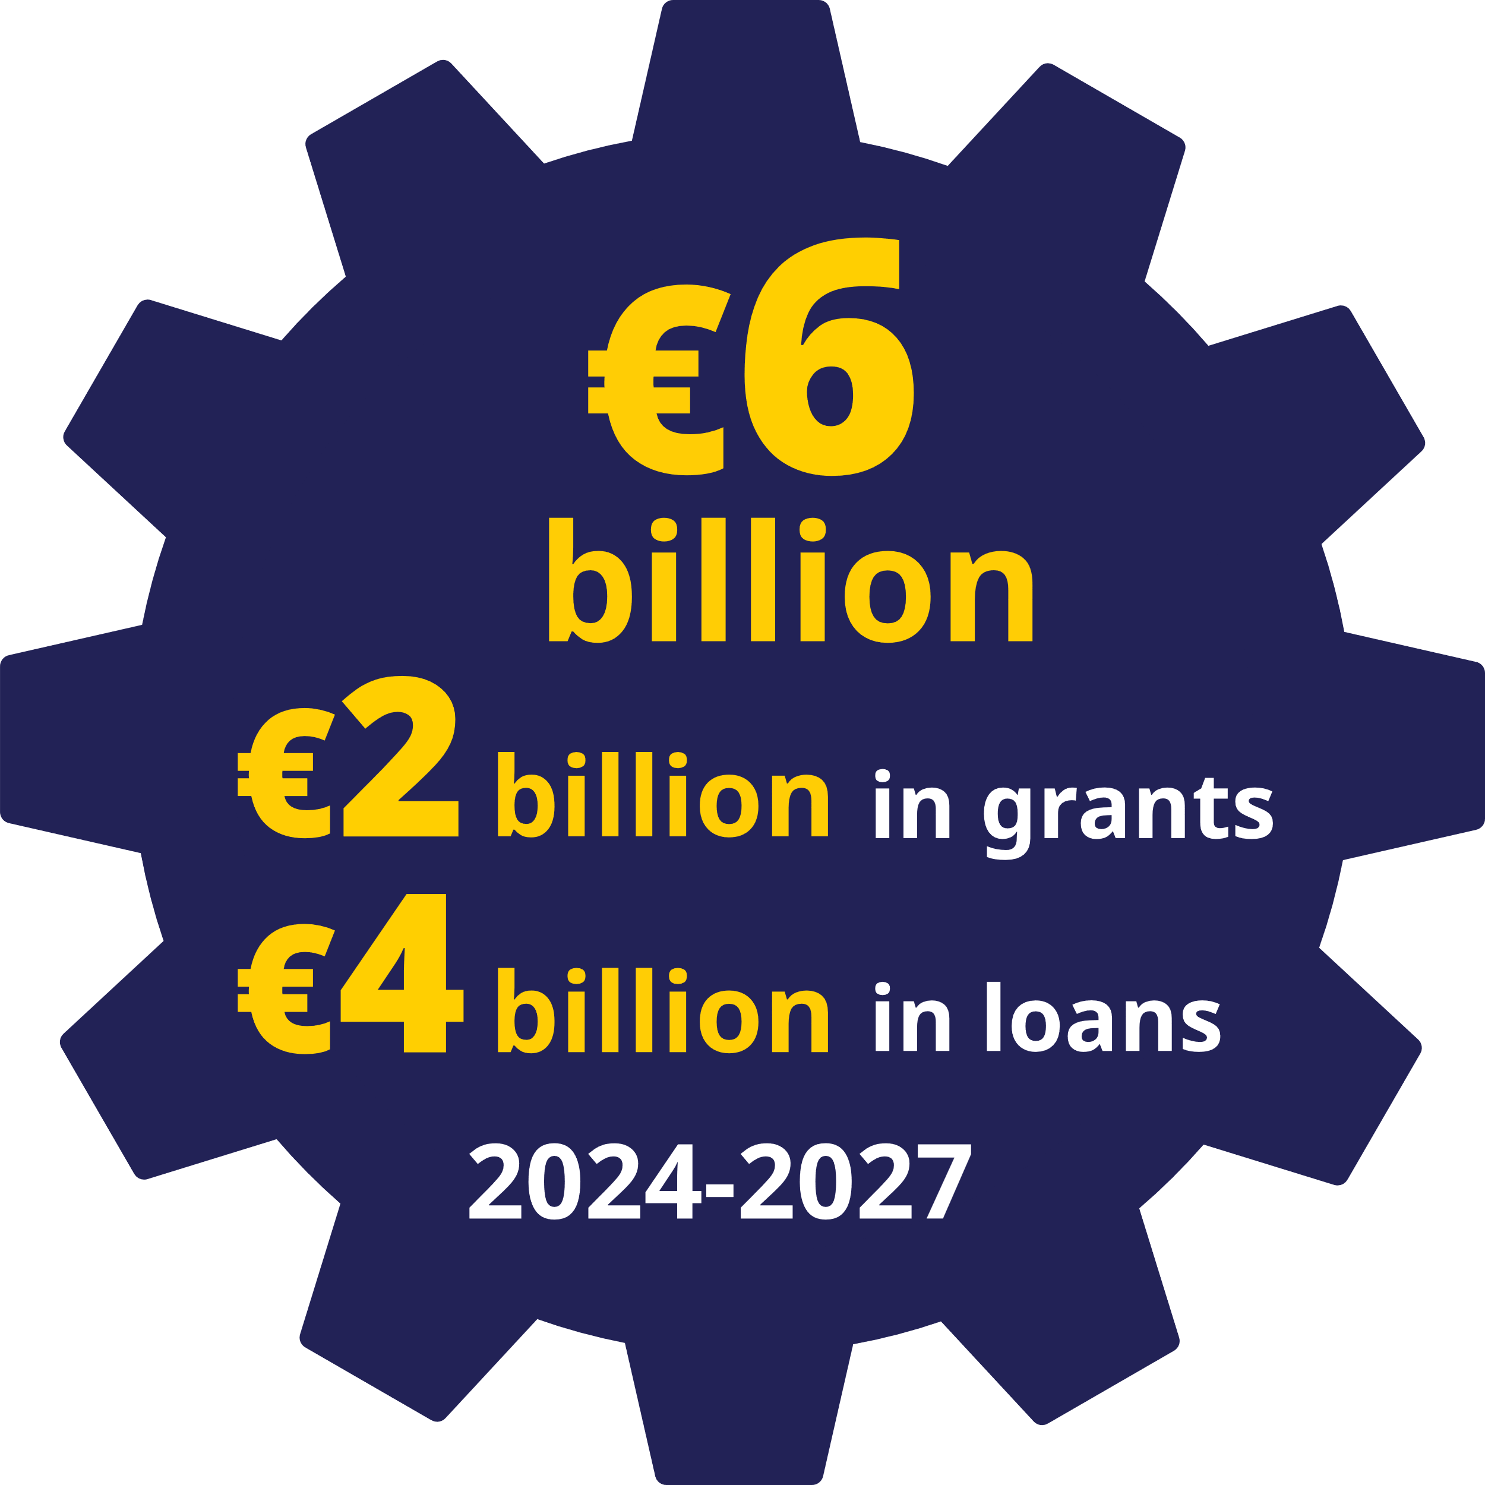
Increased financial assistance
Proposal of a new financing instrument: the Reform and Growth Facility for the Western Balkans, combining grants and loans.
Key objective to support the implementation of socio-economic reforms necessary to unlock economic growth potential
€3 billion to go to direct support to the national
budgets of partners.
At least €3 billion will deliver investments through
the Western Balkans Investment Framework (WBIF).
Complements the current financial assistance under IPA III.

Slide 8
Reform Agendas
Each government will prepare a reform agenda linked to the implementation of specific socio-economic reforms and reforms related to the fundamentals of the enlargement process, including the rule of law
The “Reform Agendas” will be built on and replace the structural reform section of the Economic and Reform Programmes for the Western Balkans.
Indicative reform priorities:
- Governance, Public Administration Reform, and Public Financial Management - Private sector development and business environment - Energy and green transition - Digitalisation - Human capital - Rule of law

Slide 9
Payment conditions
Payments are linked to the achievement of quantitative and qualitative steps linked to these measures over the period 2024-2027. Payments will occur twice a year.
payments subject to the following conditions:
Preconditions: democracy, rule of law and human rights (+ specific conditions that Serbia and Kosovo engage constructively in the normalization of their relations)
General conditions: Macro-financial stability, sound public financial management, transparency and oversight of the budget (same as usual budget support)
Payment conditions: specific to partner, defined in reform agendas

Slide 10
Payments – other elements
Prefinancing (7%) in Q3 2024. Regular bi-annual payments in Q2 and Q4 of each year (payment requests, assessments and disbursements to be performed over three months).
In case the payment conditions are not met, the Commission will deduct a corresponding amount from the payment. Redistribution of funds to other countries if conditions still not met one year later.

Slide 11
Thank you

